Slide 1



Advanced Digital System Design Course
Sebastián Caicedo Dávila
0635930

Slide 2



Advanced Digital System
Design Course

Slide 3
Stoplight Controller Design and Implementation

Slide 4
Problem Situation Statement
Detectors C sense the presence of cars waiting on the secondary street. If there’s no car on the secondary street, main street’s stoplight remains green.
If there are cars on the secondary street, the main street’s stoplight changes from green to red, following G-Y-R, and the secondary street’s stoplight changes from red to green, following R-Y-G.
The secondary street’s stoplight remains green just a TCS time, since the car is detected. When TCS is finished, the secondary street’s stoplight changes following G-Y-R and the main street’s stoplight changes following R-Y-G.
The latter is valid even when there are cars waiting on the secondary street, which means, the main street’s stoplight must return to green at least a TCP time, where TCP>>TCS.

Slide 5
Solution Proposal
As a possible solution, we can propose the integration of two state machines: one for the time control, and the other for the stoplights control.
We can get from the problem’s literature that the main and secondary streets’ times are adjacent to each other, so we can use a unique input variable A, so it will have a 0 logic state when time TCP is finished and time TCS is active, an so on, a 1 logic state when time TCS is finished and TCP is active.
Following the same strategy, for the stoplights control, we should implement a control machine which remains green for the main street while TCP time remains active and DO NOT exist cars waiting on the secondary street. It should also maintain the transitions overlapped, so yellow in both stoplights CANNOT take place. It should also assure that the secondary street’s stoplight remains green a time TCS.

Slide 6
Time Control Design
In order to have a proper time control, we should design a two states machine and one only input, which corresponds to the signal taken from a modulus 4 descendent counter (due TCP=4TCS), and as outputs, it has our control variable A, set and enable outputs for the control of the counter.
Modulus 4 descendent Counter
Clk
Time Control
FSM
Clk
A
Enable
Zero
Set

Slide 7
Time Control Design: State Machine Design
The prior idea, lead us to the design via state diagram of the time control state machine.
As simple as two states, the diagram pictures the function of the machine.
0
TCS
TCP
1

Slide 8
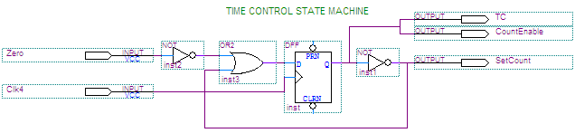
Time Control Design Implementation
Present State |  | Next State Q* |  | Outputs
_{Nombre} | Q | Z=0 | Z=1 | TC=A | SetCount | CountEnable
TCS | 0 | 1 | 1 | 0 | 1 | 0
TCP | 1 | 1 | 0 | 1 | 0 | 1

Slide 9
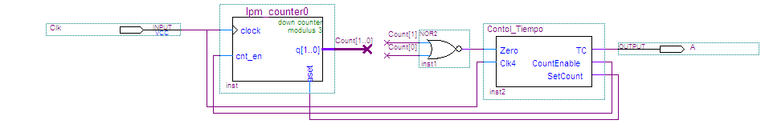

Time Control Design: Logic Diagram and Simulation
We can see how the output variable A remains high a time TCP, four times larger than the time TCS (in which it remains low). We should then set the input clock with a period of 40 seconds, in order to obtain the time specifications required.

Slide 10
Lights Control Design
For the stoplight control design, we would have a state machine with two inputs: A, corresponding to the TCS or TCP time defining variable, and a second one C, corresponding to the cars sensor on the secondary street.
Time Controller
Lights Control
FSM
Time
Control
FSM
C
Lights Control Signals
Clk1
Clk2
Modulus 4
Descendent
Counter
A

Slide 11
Lights Control Design: State Machine Design
Then we can design the state diagram for the lights controller, taking to account the restrictions and specifications given by the problem situation, as follows:
~C+AC
~A
Gm
Rs
Ym
Rs
Rm
Ys
Rm
Gs
~AC
~A
~A
A
A
A

Slide 12
Lights Control Design: States Table
State Name | Present State |  | Next State Q₁*Q₀* |  |  |  | Outputs
 | Q₁ | Q₀ | AC=00 | AC=01 | AC=11 | AC=10 | R_{m} | Y_{m} | G_{m} | R_{s} | Y_{s} | G_{s}
G_{m}R_{s} | 0 | 0 | 00 | 01 | 00 | 00 | 0 | 0 | 1 | 1 | 0 | 0
Y_{m}R_{s} | 0 | 1 | 11 | 11 | 00 | 00 | 0 | 1 | 0 | 1 | 0 | 0
R_{m}Y_{s} | 1 | 1 | 10 | 10 | 01 | 01 | 1 | 0 | 0 | 0 | 1 | 0
R_{m}G_{s} | 1 | 0 | 10 | 10 | 11 | 11 | 1 | 0 | 0 | 0 | 0 | 1

Slide 13
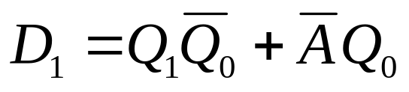
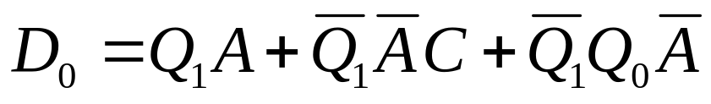
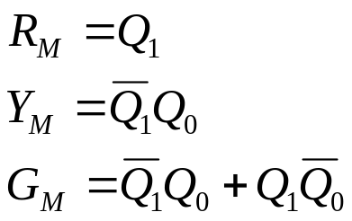
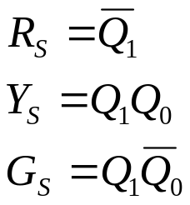
Lights Control Design: K Maps
AC Q₁Q₀ | 00 | 01 | 11 | 10 |  | AC Q₁Q₀ | 00 | 01 | 11 | 10
00 | 0 | 0 | 0 | 0 |  | 00 | 0 | 1 | 0 | 0
01 | 1 | 1 | 0 | 0 |  | 01 | 1 | 1 | 0 | 0
11 | 1 | 1 | 0 | 0 |  | 11 | 0 | 0 | 1 | 1
10 | 1 | 1 | 1 | 1 |  | 10 | 0 | 0 | 1 | 1

Slide 14
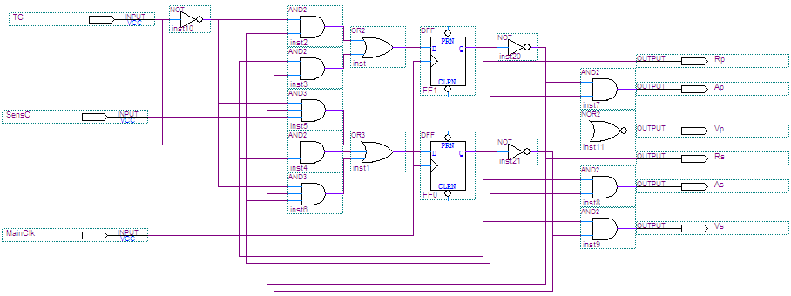
Lights Control Design: Logic Diagram

Slide 15
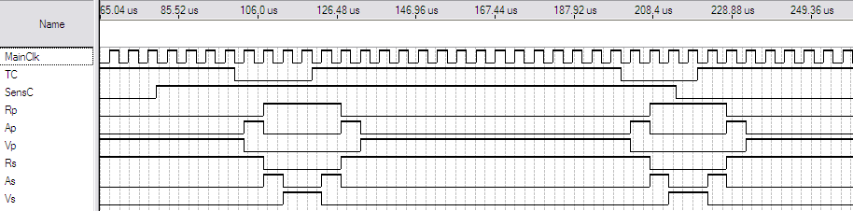
Lights Control Design: Simulation
Here we can check how the transitions occur only while the sensor C is active and the variable TC (A) is low. Otherwise the lights remain green for the main street
Here we can observe that no matter in which state the sensor C is, the transition from Red in Main Street, to Green in Main Street will always take place once the time A turns to TCP (TC=1)

Slide 16
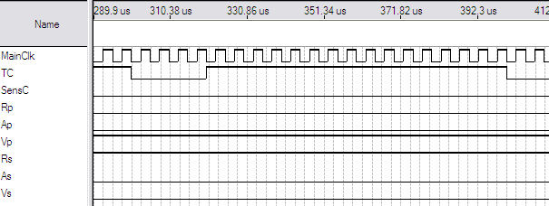
Lights Control Design: Simulation
In this simulations is evident that even when the time variable A is low (TCS, time for the secondary street), if there are no cars waiting on the secondary street, the green light of the main street will remain like so undefinedly.
The clock in this machines will work with a period of 1s, which will b the time between transitions.

Slide 17
Stoplight Control Design: Complete Implementation
Each state machine (time and stoplight), works on a different frequency. In Practice, this can be implemented using a frequency divider.
Time Controller
Lights Control
FSM
Time
Control
FSM
C
Lights Control Signals
Clk1
Clk2
Modulus 4
Descendent
Counter
A
Frequency Divider

Slide 18
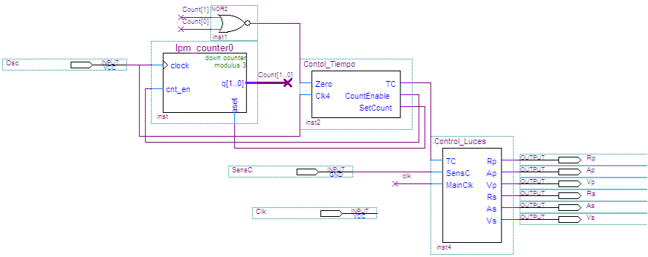
Stoplight Control Design: Complete Logic Diagram
For simulation purposes we will simulate both frequencies, as shown in the next figure:

Slide 19
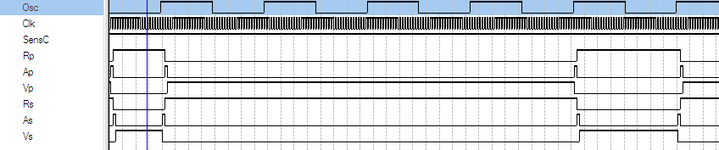
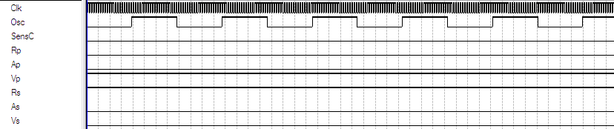
Stoplight Control Design: Prove Simulations
Simulation considering there’s always car on the secondary street
Simulation considering there’s never car on the secondary street

Slide 20
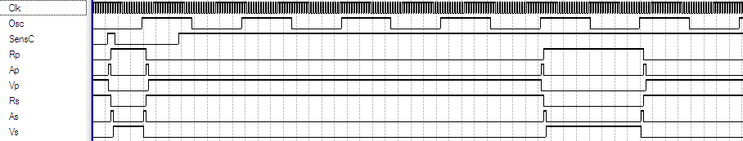
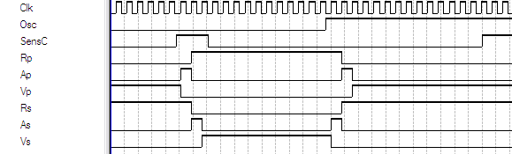
Stoplight Control Design: Prove Simulations
Simulation considering random existence of cars on the secondary street.
We can check that the stoplight does not start the changing sequence until it detects cars on the secondary street, and the TCS time is active.

